Slide 1
Linear program
Separation Oracle

Slide 2
Rounding
We consider a single-machine scheduling problem, and see another way of rounding fractional solutions to integer solutions.
We will see that by solving a relaxation, we are able to get information on how the jobs might be ordered.
We construct a solution in which we schedule jobs in the same order as given by the relaxation, and we are able toshow that his leads to a good solution .

Slide 3
1|r_{j} |ΣC_{j}
Single machine
J = {1,..., n} – jobs
p_{j} ≥ 0 – processing time of job j.
r_{j} ≥ 0 – release time of job j.
С_{j}(σ) – completion time of job j in σ.
No preemption.
The machine cannot process two jobs at the same time.

Slide 4
Example
σ₁
С₁(σ₁) + С₂(σ₁) + С₃(σ₁) = 35
J₃
J₁
J₂
0
5
10
15
20
σ₂
С₁(σ₂) + С₂(σ₂) + С₃(σ₂) = 24
J₂
J₁
J₃
0
5
10
15
20
J₁
p₁ = 1 | r₁ = 2
p₂ = 3 | r₂ = 1
p₃ = 10 | r₃ = 0
J₂
J₃

Slide 5
1|pmtn, r_{j} |ΣC_{j}
We will show that we can convert any preemptive schedule into a nonpreemptive schedule in such way that the completion time of each job at most doubles.
In a preemptive schedule, we can still only one job at a time on the machine, but we do not need to complete each job’s required processing consecutively; we can interrupt the processing of a job with the processing of other job.

Slide 6
SRPT rule
Each time that a job is completed, or at the next release date, the job to be processed next has the smallest remaining processing time among the available jobs.
Denote by σ the schedule obtained by SRPT rule and show that σ is optimal.
Assume that an optimal schedule σ* coincides with a schedule σ up to time t.

Slide 7
Exchange argument
σ*
j
i
i
j
i
t
C_{j}
C_{i}
t
i
i
i
i
j
j
t
C_{i}
C_{j}

Slide 8
Preemptive solution
С₁(σ^{pr}) + С₂(σ^{pr}) + С₃(σ^{pr}) = 22
σ^{pr}
J₃
J₂
J₁
J₂
J₃
0
5
10
15
20
J₁
p₁ = 1 | r₁ = 2
p₂ = 3 | r₂ = 1
p₃ = 10 | r₃ = 0
J₂
J₃

Slide 9
Lower bound
Let C_{j}(σ^{pr}) be the completion time of job j in an optimal preemptive schedule.
Let OPT be the sum of completion times in an optimal nonpreemptive schedule.
We have

Slide 10
Algorithm «Rounding preemptive schedule»
Find an optimal preemptive schedule σ^{pr} using SRPT.
Schedule the jobs in σ nonpreemptively in the same order that they complete in σ^{pr}.
To be more precise, suppose that the jobs are indexed such that С₁(σ^{pr}) ≤ С₂(σ^{pr}) ≤ … ≤ С_{n}(σ^{pr}). Then we schedule job 1 from its release date r₁ to time r₁ + p₁. We schedule job 2 to start as soon as possible after job 1; that is, we schedule it from max(r₁ + p₁, r₂) to max(r₁ + p₁, r₂) + p₂. The remaining jobs are scheduled analogously.
We will show that scheduling nonpreemptively in this way does not delay the jobs by too much.

Slide 11
Example
С₁(σ^{pr}) + С₂(σ^{pr}) + С₃(σ^{pr}) = 22
σ^{pr}
J₃
J₂
J₁
J₂
J₃
0
3
5
10
15
20
σ
С₁(σ) + С₂(σ) + С₃(σ) = 25
J₁
J₂
J₃
0
2
3
6
16

Slide 12
Lemma 11.1
For each job j = 1,…,n, С_{j}(σ) ≤ 2С_{j}(σ^{pr}).

Slide 13
Proof
Let us first derive some easy lower bounds on С_{j}(σ^{pr}). Since we know that j is processed in σ^{pr} after jobs 1,…, j−1, we have
By construction it is also the case that

Slide 14
Proof
Consider the nonpreemptive schedule constructed by the algorithm, and focus on any period of time that the machine is idle; idle time occurs only when the next job to be processed has not yet been released.
Consequently, in the time interval there cannot be any point in time at which the machine is idle.
Therefore, this interval can be of length at most

Slide 15
2-approximation
Theorem 11.2
Scheduling in order of the completion times of an optimal preemptive schedule is a 2-approximation algorithm for scheduling jobs on a single machine with release dates to minimize the sum of completion times.

Slide 16
1|r_{j} |Σw_{j}C_{j}
Single machine
J = {1,..., n} – jobs
p_{j} ≥ 0 – processing time of job j.
r_{j} ≥ 0 – release time of job j.
w_{j} ≥ 0 – weight of job j.
С_{j}(σ) – completion time of job j in σ.
No preemption.
The machine cannot process two jobs at the same time.
.

Slide 17
1|pmtn, r_{j} |Σw_{j}C_{j}
The algorithm “Rounding preemptive schedule” and analysis give us a way to round any preemptive schedule to one whose sum of weighted completion times is at most twice more.
Unfortunately, we cannot use the same technique of finding a lower bound on the cost of the optimal nonpreemptive schedule by finding an optimal preemptive schedule.
Unlike the unweighted case, it is NP-hard to find an optimal schedule for the preemptive version of the weighted case.

Slide 18
What we use to obtain the 2-approximation?
We can give a linear programming relaxation of the problem with variables C_{j} such that these inequalities hold within a constant factor, which in turn will lead to a constant factor approximation for the 1|r_{j} |Σw_{j}C_{j} problem.

Slide 19
Variables and constraints
Denote by C_{j} the completion time of job j.
We want to minimize
The first set of constraints is easy: for each job j = 1,…, n, job j cannot complete before it is released and processed, so that C_{j} ≥ r_{j} + p_{j}.

Slide 20
Second set of constraints
Consider some set S ⊆ J of jobs and the sum
This sum is minimized when all the jobs in S have a release date of 0 and all the jobs in S finish first in the schedule.
Assuming these two conditions hold, then any completion time C_{j}(σ) for j∈S is equal to p_{j} + the sum of all processing times of the jobs in S that preceded j in the schedule.
Then in the product p_{j} C_{j}, p_{j} multiplies itself and the processing of all jobs in S that preceded j in the schedule.
The sum must contain p_{j} p_{k} for all pairs j,k∈S.

Slide 21
Queyranne’s inequality

Slide 22
LP(1|r_{j} |Σw_{j}C_{j})

Slide 23
Algorithm 1|r_{j} |Σw_{j}C_{j}
Find an optimal solution σ* = (С₁(σ*), С₂(σ*), …, С_{n}(σ*)) of the LP(1|r_{j} |Σw_{j}C_{j}).
Schedule the jobs in σ nonpreemptively in the same order that they complete in σ*.
Output (σ)

Slide 24
3-approximation
Theorem 11.3
Scheduling in order of the completion times of σ* is a 3-approximation algorithm for scheduling jobs on a single machine with release dates to minimize the sum of weighted completion times.

Slide 25
Proof
Assume that the jobs are reindexed so that С₁(σ*) ≤ С₂(σ*) ≤ … ≤ С_{n}(σ*).
As in the proof of Lemma 11.1, there cannot be any idle time in the time interval
Therefore it must be the case that

Slide 26
Let l∈{1,…, j} be the index of the job that maximizes max_{k=1,…,j}r_{k} so that r_{l} = max_{k=1,…,j}r_{k}.
We have С_{j}(σ*) ≥ С_{l}(σ*) and С_{l}(σ*) ≥ r_{l} by the LP constraints; thus С_{j}(σ*) ≥ max_{k=1,…,j}r_{k}.
Consider set S = {1,…, j}.
From the fact that σ* is a feasible LP solution , we know that
Since С₁(σ*) ≤ С₂(σ*) ≤ … ≤ С_{j}(σ*), we have
By combining these two inequalities we see that

Slide 27
Proof

Slide 28
How to solve LP?

Slide 29
Ellipsoid method (draft)
The input for the algorithm is a system of inequalities P ={Cx ≤ d} with n variables in integral coefficients.
We would like to determine whether P is empty or not, and if it is nonempty, we would like to find a point in P.
Let N=2n((2n+1)⟨C⟩ + n⟨d⟩ − n³) and k = 0
Find a “big” ellipsoid E₀(A₀,a₀), that contains our polytope P.
If k = N, then STOP! (Declare P empty.)
If a_{k} ∈ P, then STOP! (A feasible solution is found.)
If a_{k} ∉ P, then choose an inequality that is violated by a_{k}.
6. Create a new ellipsoid E_{k+1}(A_{k+1},a_{k+1}), go to 3.

Slide 30
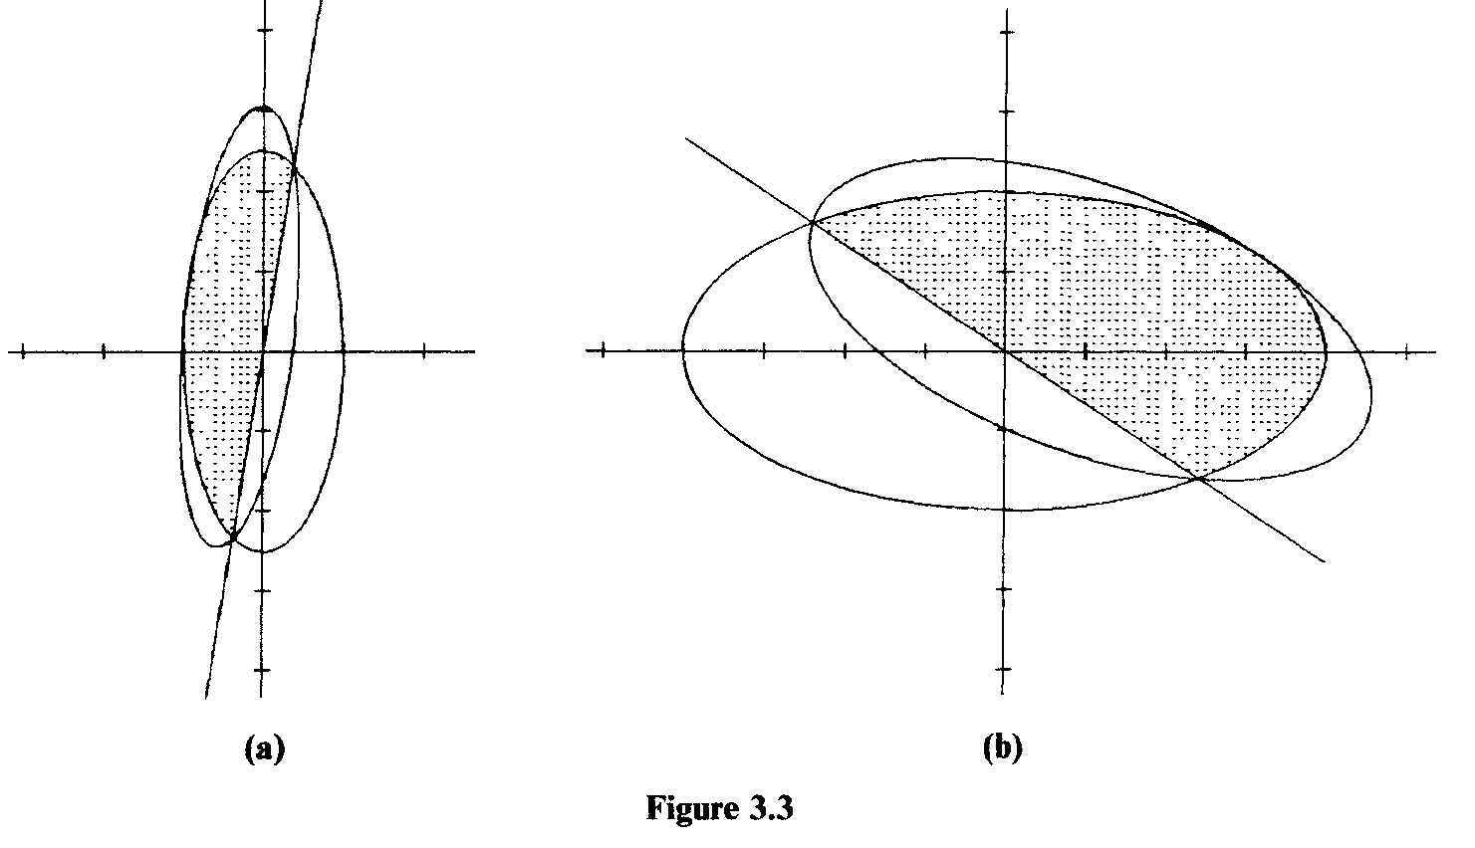
Löwner-John ellipsoid
E=E(A,a) = {x ∈ R^{n} |(x−a) ^{T}A⁻¹(x−a) ≤ 1}
Eʹ(A,a,c) = E(A,a) ∩ {x ∈ R^{n} |c^{T}x ≤ c^{T}a}

Slide 31
Ellipsoid method (draft)
The input for the algorithm is a system of inequalities P ={Cx ≤ d} with n variables in integral coefficients.
We would like to determine whether P is empty or not, and if it is nonempty, we would like to find a point in P.
Let N=2n((2n+1)⟨C⟩ + n⟨d⟩ − n³) and k = 0
Find a “big” ellipsoid E₀(A₀,a₀), that contains our polytope P.
If k = N, then STOP! (Declare P empty.)
If a_{k} ∈ P, then STOP! (A feasible solution is found.)
If a_{k} ∉ P, then choose an inequality that is violated by a_{k}.
Create a new ellipsoid E_{k+1}(A_{k+1},a_{k+1}), go to 3.
We need a polynomial time procedure (separation oracle) for steps 4 and 5.

Slide 32
How to find the violated constraint?
Given a solution σ.
Reindex the variables so that С₁(σ) ≤ С₂(σ) ≤ … ≤ С_{n}(σ).
Let S₁ ={1}, S₂ ={1, 2},…, S_{n} ={1,…, n}.
We claim that it is sufficient to check whether the constraints are violated for the n sets S₁, S₂,…, S_{n}.
If any of these n constraints are violated, then we return the set as a violated constraint.
If not, we show below that all constraints are satisfied.

Slide 33
Separation oracle
Lemma 11.4
Given variables C_{j}, if constraints (2) are satisfied for the n sets S₁, S₂,…, S_{n}, thet they are satisfied for all S ⊆ J.

Slide 34
Proof (1)
Let S ⊆ J be a constraint that is not satisfied; that is
We will show that then there must be some set S_{i} that is also not satisfied. We do this by considering changes to S that decrease the difference
Any such change will result in another set S′ that also does not satisfy the constraint.

Slide 35
Removing a job k from S decreases x if
Adding a job k to S decreases x if

Slide 36
Removing of jobs
Let l be the highest indexed job in S.
We remove l from S if
In this case the resulting set S \ {l} also does not satisfy the constraint (2).
We continue to remove the highest indexed job in the resulting set until finally we have a set S′ such that its highest indexed job l has

Slide 37
Adding of jobs
Now suppose S′ ≠ S_{l} ={1,…, l}.
Let k < l and k∉S_{l} .
We have
It follows that, adding k to S′ can only decrease the difference
Thus we can add all k < l to S′ , and the resulting set S_{l} will also not satisfy the constraint (2).

Slide 38
Ellipsoid Method (1)
Suppose we are trying to solve LP(1|r_{j} |Σw_{j}C_{j}).
Initially, the algorithm finds an ellipsoid in R^{n} containing all basic solutions for the linear program.
Let Č be the center of the ellipsoid.
The algorithm calls the separation oracle with Č.
If Č is feasible, it creates a constraint Σw_{j}C_{j} ≤ Σw_{j}Č_{j}, since a basic optimal solution must have objective function value no greater than the feasible solution Č.
This constraint is sometimes called an objective function cut.

Slide 39
Ellipsoid Method (2)
If Č is not feasible the separation oracle returns a constraint Σa_{ij}C_{j} ≥ b_{i} that is violated by Č.
In either case, we have a hyperplane through Č such that a basic optimal solution to the linear program must lie on one side of the hyperplane.
In the case of a feasible Č the hyperplane is Σw_{j}C_{j} ≤ Σw_{j}Č_{j}.
In the case of an infeasible the Č the hyperplane is Σa_{ij}C_{j} ≥ Σa_{ij}Č_{j}.

Slide 40
Ellipsoid Method (3)
The hyperplane containing Č splits the ellipsoid in two.
The algorithm then finds a new ellipsoid containing the appropriate half of the original ellipsoid, and then consider the center of new ellipsoid.

Slide 41
Löwner-John ellipsoid
E=E(A,a) = {x ∈ R^{n} |(x−a) ^{T}A⁻¹(x−a) ≤ 1}
Eʹ(A,a,c) = E(A,a) ∩ {x ∈ R^{n} |c^{T}x ≤ c^{T}a}

Slide 42
Ellipsoid Method (3)
The hyperplane conta
The algorithm then finds a new ellipsoid containing the appropriate half of the original ellipsoid, and then consider the center of new ellipsoid.
This process repeats until the ellipsoid is sufficiently small that it can contain at most one basic feasible solution.
This solution must be a basic optimal solution.

