Slide 1

Solid body impact onto a gas-liquid interface
Ermanyuk E.V..
Lavrentyev Institute of Hydrodynamics SB RAS,
Novosibirsk
Dynamics in Siberia
March 2 -6, 2026

Slide 2




Solid body impact onto a gas-liquid interface
E.V. Ermanyuk
J.-B. Carrat
N.V. Gavrilov
N.D. Shmakova
Lavrentyev Institute of Hydrodynamics SB RAS
Novosibirsk
A.V. Cherdantsev
Kutateladze Institute of Thermophysics
SB RAS
Novosibirsk
M. Ohkusu
Research Institute for Applied Mechanics, Kyushu University, Fukuoka, Japan
P. Hicks
University of Aberdeen, UK
R. Purvis
University of East Anglia, Norwich,
UK
Dynamics in Siberia
March 2 -6, 2026

Slide 3
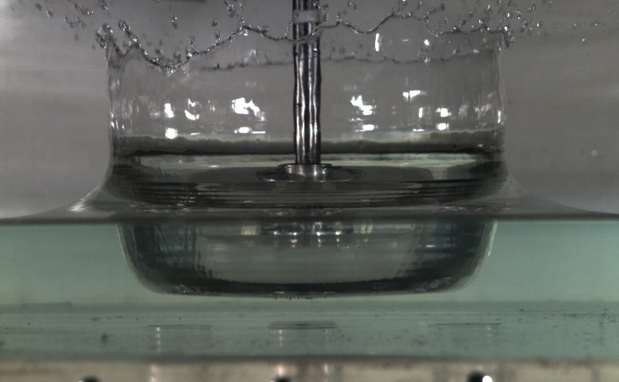
Key parameters
Liquid: density, viscosity, surface tension, speed of sound, saturated vapor pressure...
Gas: density, viscosity, speed of sound...
Equations of state for liquid (ideal) and gas (Newtonian liquid)
Nody (impactor): shape, impact speed, mass, stiffness, rugosity, wettability, porosity...
Gravity acceleration
Key non-dimensional numbers:
Reynolds number
Weber number
Ohnesorge number
Capillary number
Stokes number
Density and
viscosity ratios

Slide 4
Key parameters
Liquid: density, viscosity, surface tension, speed of sound, saturated vapor pressure...
Gas: density, viscosity, speed of sound...
Equations of state for liquid (ideal fluid) and gas (Newtonian fluid)
Nody (impactor): shape, impact speed, mass, stiffness, rugosity, wettability, porosity...
Gravity acceleration neglected
Key non-dimensional numbers:
Reynolds number
Weber number
Ohnesorge number
Capillary number
Stokes number
Density and
viscosity ratios

Slide 5
Key reviews:
A. A. Korobkin and V. V. Pukhnachev (1988) “Initial stage of water impact,” Annual Rev. Fluid Mech., 20, 159–186
A. L. Yarin (2006) “Drop impact dynamics: Splashing, Spreading, Receding, Bouncing…” Annual Rev. Fluid Mech., 38, 159-192
S. T. Thoroddsen, T. G. Etoh, and K. Takehara (2008) “High-Speed Imaging of Drops and Bubbles” Annual Rev. Fluid Mech., 40, 257-285.
C. Josserand and S. T. Thoroddsen (2016) “Drop Impact on a Solid Surface” Annual Rev. Fluid Mech., 48, 365-391.
D. van der Meer (2017) “Impact on Granular Beds” Annual Rev. Fluid Mech., 49, 463-484.
D. Lohse (2022) “Fundamental Fluid Dynamics Challenges in Inkjet Printing” Annual Rev. Fluid Mech., 54, 349-382

Slide 6
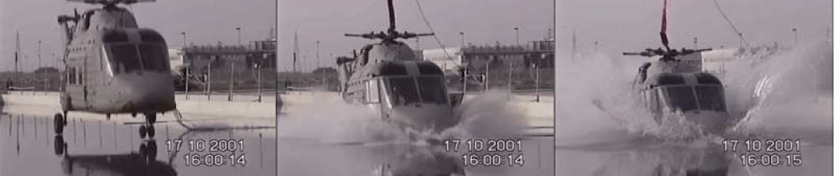
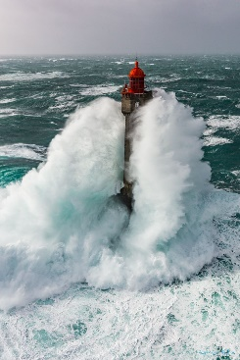
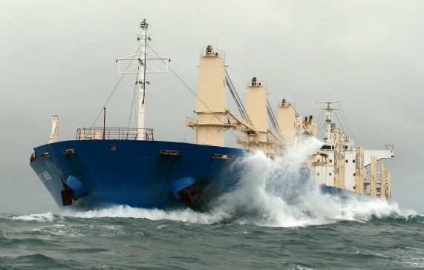
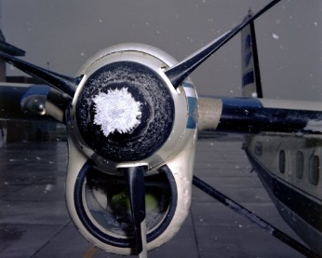
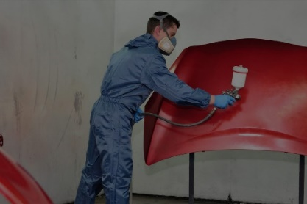
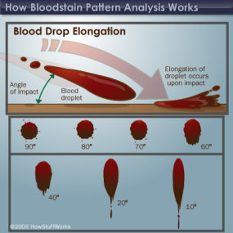
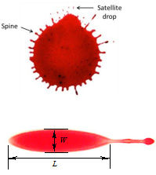
Length scale D ⁓ O(1 м)÷O(10 м)
ship slamming,
ditching of airplanes and helicopters,
liquid sloshing in oil and LNG carriers....
Points of interest: evaluation of hydrodynamic loading, stress and deformation in structures
Length scale D ⁓ O(0.01 mm)÷O(1 mm)
jet printers (inks, melted alloys), aerosol coating, icing of airplanes, helicopters, ships, wind turbines.....
forensic analysis…
Points of interest: study new physical mechanisms, optimisation of technology ...

Slide 7

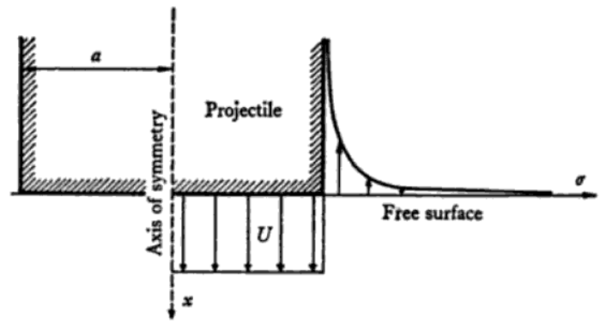
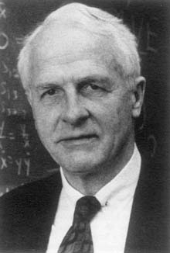
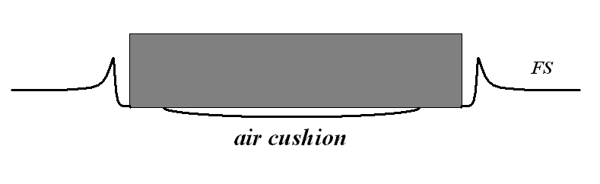
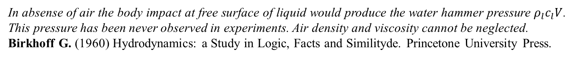
Impact of a flat-nosed body
“…the motion produced by the impact of a flat-nosed body is identical only instantaneously with that (in one half of) the flow field of a flat plate moving through an infinite fluid”
Batchelor G.K. (1967) Introduction to Fluid Mechanics. Cambridge University Press
Fugita (1954),
Chuang (1966),
Verhagen (1967)
In absense of air the body impact at free surface of liquid would produce the water hammer pressure $ρ_{l}c_{l}V$. This pressure has been never observed in experiments. Air density and viscosity cannot be neglected.
Birkhoff G. (1960) Hydrodynamics: a Study in Logic, Facts and Similityde. Princetone University Press.

Slide 8
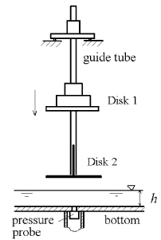
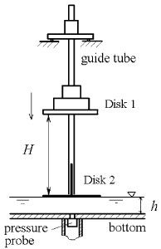
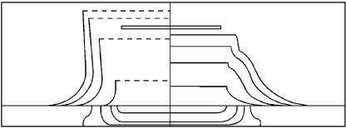
partial vacuum (13% )
Yakimov (Fluid Dyn 1975)
normal atmosphere
Ermanyuk & Ohkusu
(J. Fluids and Structures 2005)
Air cushion trapped under the lower disk
no air cushion under the lower disk

Slide 9
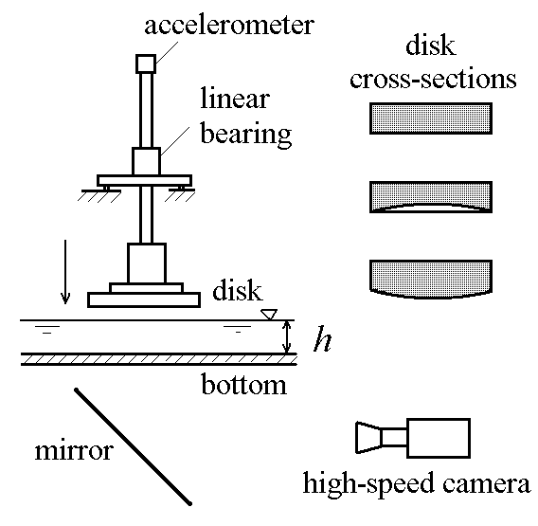
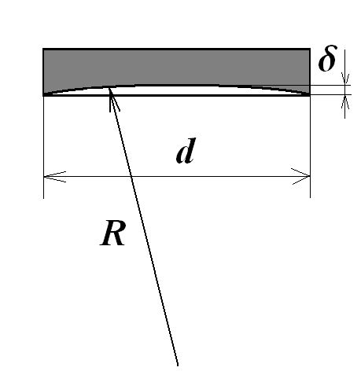
Hydrodynamic loading
hydrodynamics load
μ added mass
where b – submergence of lower point of the body below undisturbed free surface
Two generic cases:
1) constant speed impact
2) speed jump of a flat-nosed body at impact onto free surface
Experimental setup
disc diameter d = 18cm,
radius of bottom curvature:
R = 130 cm concave
R = 130 cm convex
R= ∞ flat
High-speed camera: Motion Xtra HG-100K
Frame rate: 500 to 5000 fps

Slide 10
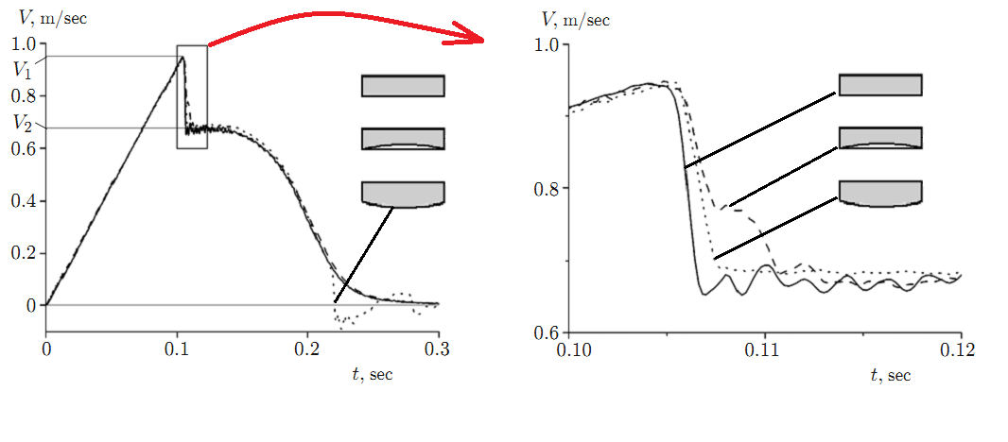

Impact speed versus time
Batchelor G.K.
Birkhoff G.
Impact height H=5cm, liquid depth h = 6cm
Momentum conservation:
Key principles:
Velocity jump can be evaluated from momentum conservation
Time scale depends on details of the flow geometry.

Slide 11
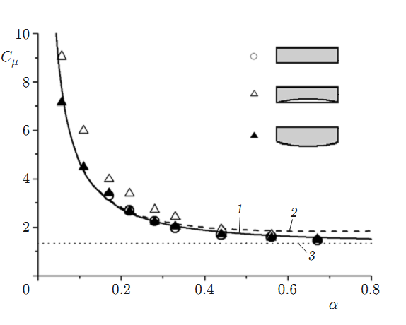
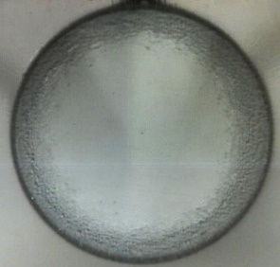
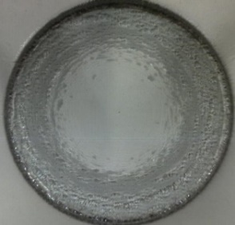
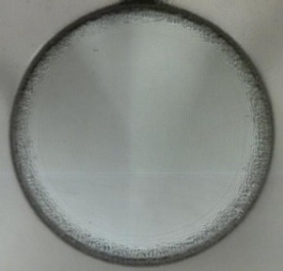
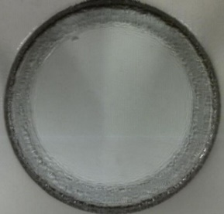
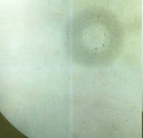
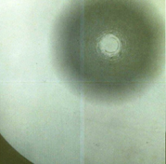
Added muss as function of non-dimensional depth
Chebakov (Appl. Math. Mech. 1974)
flat bottom
concave bottom
convex bottom
Ermanyuk & Gavrilov (J. Appl. Mech. Techn. Phys. 2011)

Slide 12
Is air trapping persistent for a non-zero deadrise angle?
What is the effect of deadrise angle and impact speed?
Air trapping at normal impact of a flat disk onto a gas-liquid interface

Slide 13
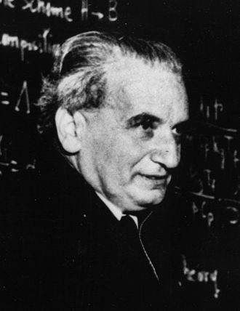
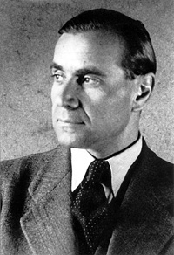
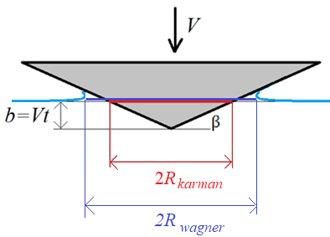
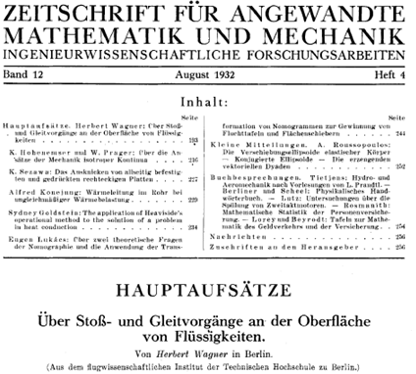
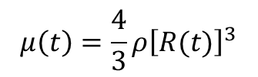

Flow scheme for a body of “arbitrary” geometry
H. Wagner
T. Karman
Impact of wedge / conus onto free surface of liquid
Karman (1929)
Wagner (1932)

Slide 14
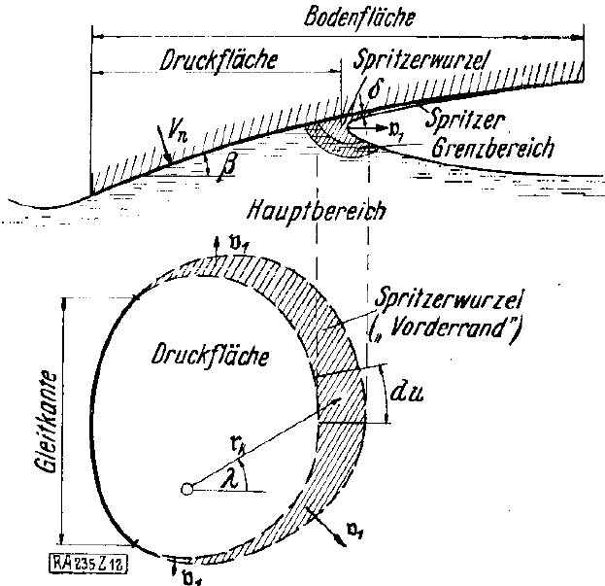
Wagner, H. 1932 Uber Stoß- und Gleitvorgӓnge an der Oberflӓche von Flüssigkeiten. ZAMM 12 (4), 193–215
Schmieden, C. 1953 Der Aufschlag von Rotationskӧrpern auf eine Wasseroberflӓche. ZAMM 33 (4), 147–151.
Scolan, Y.-M. & Korobkin, A.A. 2001 Three-dimensional theory of water impact. Part 1. Inverse Wagner problem. JFM 440, 293–326.
Scolan, Y.-M. & Korobkin, A.A. 2006 Three-dimensional theory of water impact. Part 2. Linearized Wagner problem. JFM 549, 343–373.

Slide 15
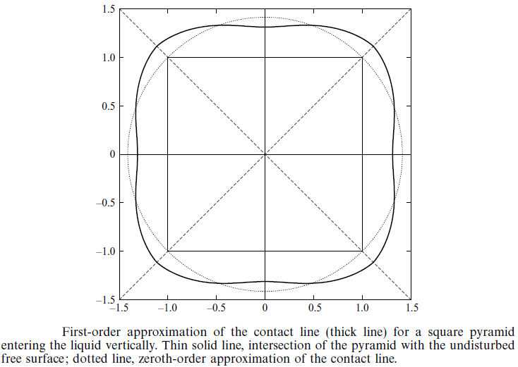
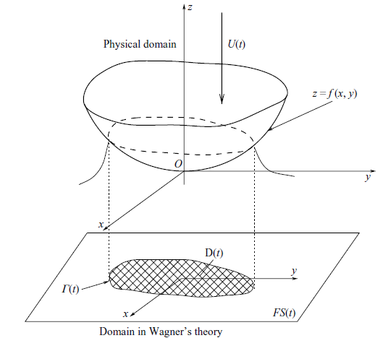
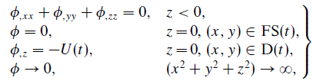

Contact line for a square pyramid
Shape of free surface
at
Scolan, Y.-M. & Korobkin, A.A. 2006 Three-dimensional theory of water impact. Part 2. Linearized Wagner problem. JFM 549, 343–373.

Slide 16


Length scale D ⁓ O(0.1mm)÷O(1mm)
E.Q. Li, S.T. Thoroddsen (2015) “Time-resolved imaging of a compressible air disk under a drop impacting on a solid surface” J. Flluid Mech. 780. 636-648.
C. Josserand and S.T. Thoroddsen (2016) “Drop Impact on a Solid Surface” Annual Rev. Fluid Mech., 48, 365-391:
“With 50-ns laser pulses for each video frame, interferometry can be realized at 5 Mfps to obtain the time-resolved evolution of the air-layer profile for higher impact velocities”
Sigurdur
Thoroddsen
126 frames with resolution 800x600
at 7 million fps

Slide 17
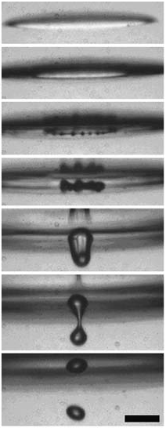
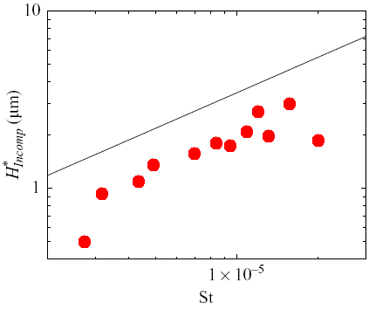
Problems with measurements for droplet impact
Length scale D ⁓ O(0.1mm)÷O(1mm)
Mani et al. (JFM 2010)
air trapping and
air-bubble formation
Thoroddsen et al.
(JFM 2003)

Slide 18
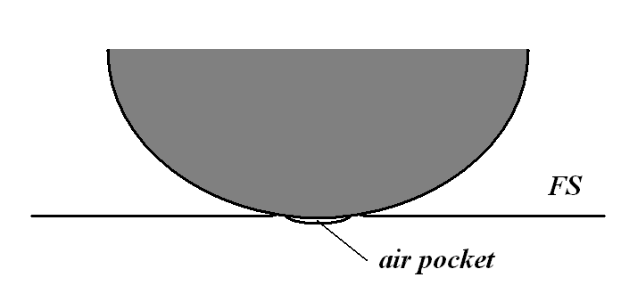
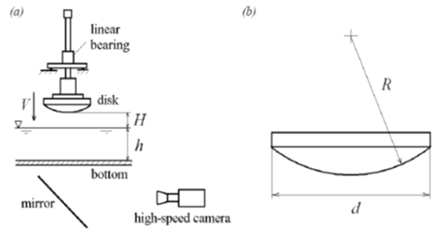
Air trapping at impact of a sphere onto a gas-liquid interface
Smith, Li & Wu (JFM 2003), Korobkin, Ellis & Smith (JFM 2008), Hicks & Purvis (JFM 2010), Mani, Mandre & Brenner (JFM 2010)
Hicks & Purvis (Phys. Fluids 2011),
Hicks, Ermanyuk, Gavrilov & Purvis (JFM 2012) Hicks & Purvis (JFM 2013)
Approximation:
lubrication regime in thin air layer
+ liquid inertia
Key parameters:
dynamic viscosity of gas,
liquid density,
radius of curvature of body
Experimental setup
Hicks, Ermanyuk, Gavrilov & Purvis (JFM 2012)

Slide 19
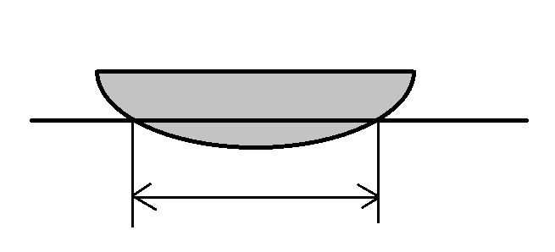



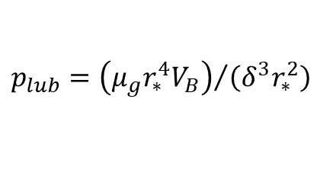
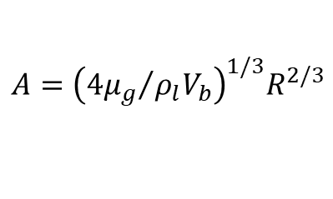
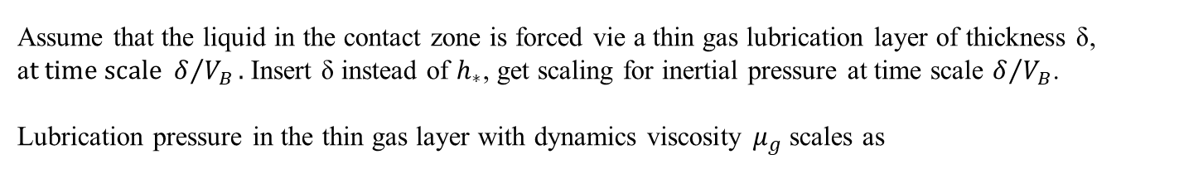
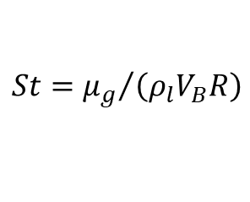
Physical scaling
radius of contact, R – radius of curvature, – penetration depth
added mass of a disk
inertial pressure
hydrostatic pressure
«instantaneous Froude number ${Fr}_{∗}≫1$ at small t and large R
Assume that the liquid in the contact zone is forced vie a thin gas lubrication layer of thickness δ, a$t time scale δ/{V_{B}}.$ Insert δ instead of $h_{∗}$, get scaling for inertial pressure at time scale $δ/{V_{B}}$.
Lubrication pressure in the thin gas layer with dynamics viscosity $μ_{g}$ scales as
$${p_{lub}=\left(μ_{g}r_{∗}^{4}V_{B}\right)}/{\left(δ^{3}r_{∗}^{2}\right)}$$
Assume $p_{lub}=p_{inert}$
Scaling:
$$δ\sim R {St}^{2/3}$$
, with Stokes number
$$St={μ_{g}}/{\left(ρ_{l}V_{B}R\right)}$$
Initial radius of the trapped air region scales as
$$A={\left({4μ_{g}}/{ρ_{l}V_{b}}\right)}^{1/3}R^{2/3}$$

Slide 20

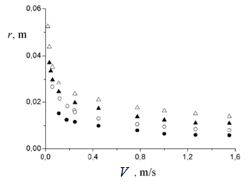
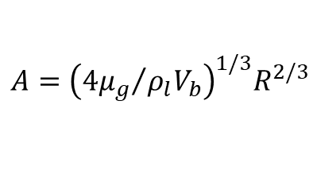
Air trapping
Initial radius of the contact zone
Radius of curvature R:
80 (∆), 60 (▲), 45 (○), 30 (●) сm
$$A={\left({4μ_{g}}/{ρ_{l}V_{b}}\right)}^{1/3}R^{2/3}$$
Coefficient in r=CA
C= 3.86 – experimental value
C= 3.8 – calculated value Hicks & Purvis (2010)

Slide 21
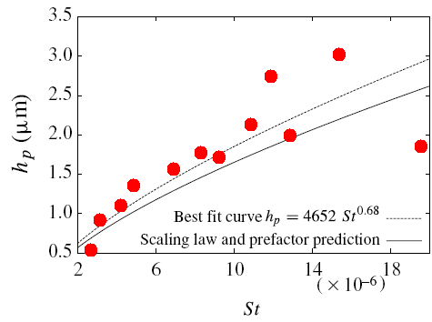
Radius of trapped air domain at impact of a droplet onto a liquid
Mani, Mandre & Brenner (JFM 2010)
Log-log scale
Hicks, Ermanyuk, Gavrilov & Purvis (JFM 2012)
Linear scale
Loss of axial symmetry at low impact speed

Slide 22
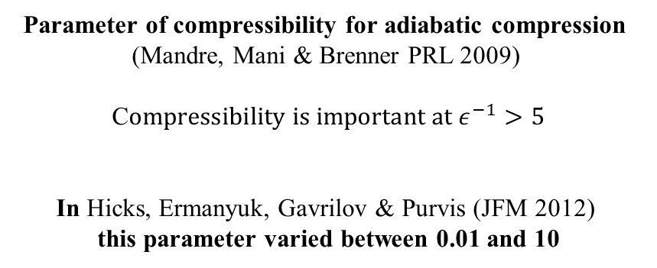
Influence of gass compressibility
Isotermal gas compression :
Mandre, S., Mani, M. & Brenner, M. P. 2009 Precursors to splashing of liquid droplets on a
solid surface // Phys. Rev. Lett. 102 (13), 134502.
Adiabatic gas compression:
Mani, M., Mandre, S. & Brenner, M. P. 2010 Events before droplet splashing on a solid surface // J. Fluid Mech. 647, 163–185.
Parameter of compressibility for adiabatic compression
(Mandre, Mani & Brenner PRL 2009)
C$ompressibility is important at ε^{−1}>5$
In Hicks, Ermanyuk, Gavrilov & Purvis (JFM 2012)
this parameter varied between 0.01 and 10

Slide 23
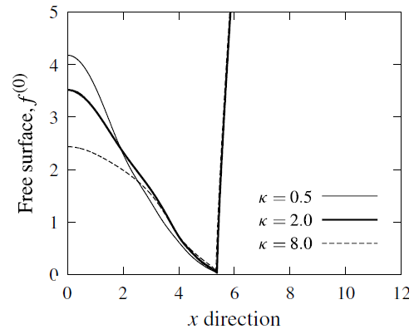
Improved model with full equation of energy conservation in the gas layer taking into account dependence of gas viscosity on temperature
Hicks P.D. , Purvis R. 2013. “Liquid-solid impacts with compressible gas cushioning”// J. Fluid Mech. 735. 120-149.
Radius of trapped air domain does not depend on air compressibility parameter
Thickness of trapped air domain depends on compressibility parameter and is in a reasonably good agreement with estimates from “adiabatic” gas compression theory.

Slide 24
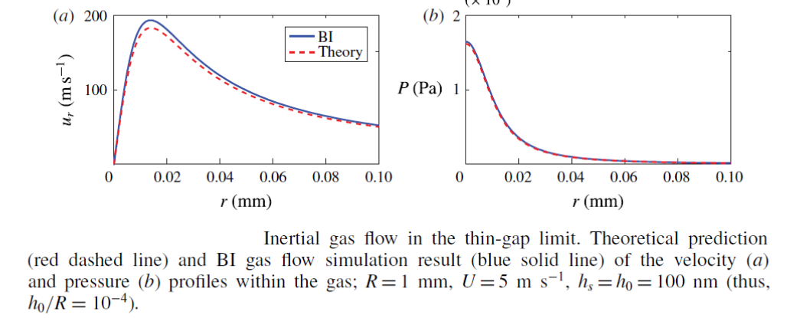
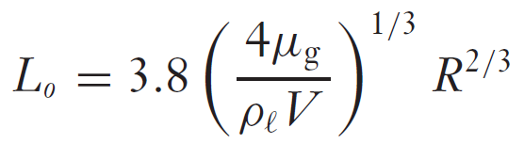

Typical gas speed at impact of a droplet onto a rigid flat surface
Bouwhuis W., Hendrix M.H.W., van der Meer D., Snoeijer J.H. Initial surface deformations during impact on a liquid pool // J. Fluid Mech. 2015. V. 771. P. 503-519.
C. Josserand and S.T. Thoroddsen (2016) “Drop Impact on a Solid Surface”
Annual Rev. Fluid Mech., 48, 365-391.
g$as compression parameter ε^{−1}$
varied between 0.01 and 10 (Hicks et al 2012)
and between 5 and 40 (Li & Thoroddsen 2015)

Slide 25


Air trapping at impact of a conus onto a liquid
Experimental setup
Visualisation using total internal reflection (TIR)
Jain, Gauthier, van der Meer (Exp Fluids 2021), Jain, Vega-Martinez, van der Meer (JFM 2021)

Slide 26



Slide 27


Trapped air region collapse with formation of a single central air bubble
(blue domain in regime map)
Trapped air region collapse with formation of a gas-bubble necklace
(red domain in the regime map)

Slide 28


Time-history of outer and inner radii of the wetted area
Outer (inner) radius evolves linearly (exponentially) with time
Outer radius expansion speed (Wagner speed)
(Schmieden, ZAMM 1953)
Karman speed

Slide 29


Slide 30













Scaling laws for sphere and conus
added mass of a disk
$$h_{∗}=Vt$$
penetration depth
contact zone radius
$$r_{∗}\left(t\right)=Vt/\tan\left(β\right)$$
$$p_{i}\sim \frac{ρ_{l}}{π}2^{3/2}R^{1/2}V^{3/2}t^{−1/2}$$
inertial pressure
$$p_{i}\sim ρ_{l}V^{2}/\tan\left(β\right)$$
$$p_{h}=ρ_{l}gVt$$
hydrostatic pressure
$${Fr}_{∗}=\frac{V^{2}}{gD}\frac{2^{5/2}}{π}{\left(\frac{R}{h_{∗}(t)}\right)}^{3/2}$$
«instantaneous» Froude number
$${Fr}_{∗}(t)\sim V/\left(gt\tan\left(β\right)\right)$$
Pressure scale in a sqeeze flow between disks from the lubrication theory for a thin air layer
with dynamic viscosity $μ_{g}$ and thickness δ
$$δ/{r_{∗}\sim \tan{β}}$$
$${p_{lub}=\left(μ_{g}V\right)}/{\left[r_{∗}{\left(\tan{β}\right)}^{3}\right]}$$
$${p_{lub}=\left(μ_{g}r_{∗}^{2}V\right)}/{\left(δ^{3}\right)}$$
Assume $p_{lub}=p_{i}$
Initial radius of the trapped air region scales as
$$A={\left({4μ_{g}}/{ρ_{l}V}\right)}^{1/3}R^{2/3}$$

Slide 31




Initial radius of trapped air region versus impact speed at different values of the deadrise angle
Initial radius of trapped air region as function of

Slide 32





двигатель
резервуар
Тело
290 мм
465 мм
470 мм
Камера
Two liquids with different surface tensions:
distilled water, $σ=73$ мН/м
2.5% butanol-water solution (BWS), $σ=40$ мН/м
High-speed video:
1000 to 20000 fps
resolution 1024 x1024 pixels
Experimental setup

Slide 33

Regime map for pyramid and conus

Slide 34

Regime map for wedge

Slide 35



Slide 36



Square pyramid impact onto gas-liquid interface
«Exotic» patterns
Square «necklace»
Bubbles at square corners
Square donut

Slide 37




Impact of square pyramid onto gas-liquid interface
Regular case

Slide 38

“Wagner” contact line
(marked by black arrow)
Scolan & Korobkin (JFM 2006)
Carrat, Gavrilov, Cherdantsev,
Shmakova, Ermanyuk
(JFM 2026)

Slide 39

“Wagner” radial speed of contact line expansion
π/2 and 4/π – «Wagner» coefficients for wedge and conus, respectively.

Slide 40

Universal scaling law
for initial size of trapped air film
(wedge, pyramid and conus)

Slide 41


Slide 42

Scaling parameter
sphere
wedge, conus, pyramid
$$A={\left({μ_{g}}/{ρ_{l}V}\right)}^{1/3}R^{2/3}$$
low sensitivity to variation of input parameters
high sensitivity to variation of input parameters
Combination of two scaling laws allows to control the air trapping:
spherical surface with micro-structure (grooves, pyramides)
pyramid (wedge) with rounded vertex (edge)
Carrat J.-B., Gavrilov N, Cherdantsev A., ShmakovaN., Ermanyuk E. Air entrapment at impact of a conus onto a liquid // J. Fluid Mech. 2023. 966, R1
Carrat J.-B., Gavrilov N, Cherdantsev A., ShmakovaN., Ermanyuk E. Air entrapment at impact of a wedge, pyramide and conus onto a liquid // J. Fluid Mech. 2026.

Slide 43
Publications:
Carrat J.-B., Gavrilov N, Cherdantsev A., ShmakovaN., Ermanyuk E. Air entrapment at impact of a wedge, pyramide and conus onto a liquid // J. Fluid Mech. 2026.
Carrat J.-B., Gavrilov N, Cherdantsev A., ShmakovaN., Ermanyuk E. Air entrapment at impact of a conus onto a liquid // J. Fluid Mech. 2023.
Cherdantsev A.V., Gavrilov N.V., Ermanyuk E.V. Study of initial stage of entry of a solid sphere into shallow liquid with Synthetic Schlieren technique // Experimental Thermal and Fluid Science. 2021. V. 125. 110375.
Hicks P. D., Ermanyuk E. V., Gavrilov N. V., Purvis R. Air trapping at impact of a rigid sphere onto a liquid // J. Fluid Mech. 2012. V. 695. P. 310–320.
Ерманюк Е.В., Гаврилов Н.В. Экспериментальное исследование падения дисков на мелкую воду // ПМТФ. 2011. Т. 52, № 6. С. 50-57.
Ermanyuk E.V., Ohkusu M. Impact of a disk on shallow water // J. Fluids Structures. 2005. V. 20. No. 3. P. 345–357.

Slide 44
Thank you for your attention!

