Slide 1
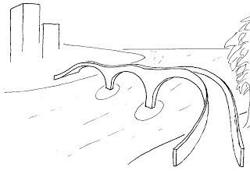
Literature and Answers. Final Part
solutions
You are here
Ministry of Education and Science of the Russian Federation National Research University
Novosibirsk State University Department of Mechanics and Mathematics
Master educational programme for teaching foreign students in English
«Modern trends in discrete mathematics and combinatorial optimization»

Slide 2
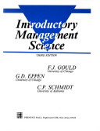
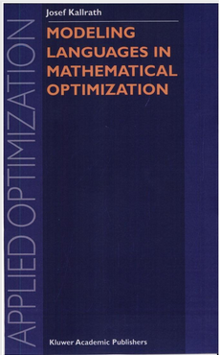
Literature
Gould F.J etc. Introduction to management science. New Jersey, 4th edition, 1993
Kallrath J. (Ed.) Modeling Languages in Mathematical Optimization. Kluwer Academic Publisher, 2004

Slide 3
Answers
Quiz 1.1
1a ; 2b; 3a; 4d
Quiz 1.2
1a ; 2a; 3a; 4a
Quiz 1.3
1a ; 2a; 3b; 4c
Quiz 2.1
a MIP; b 6; c 11;

